Slide 1
Team-MOderate
Members;
1-Kavina Ashok kumar. a
2-KANIshq raj. G
3-Nirmalraja Gopalan. m
4-Kishore kumar. p
5-thirumaraiselvan. B
6-sukesh Kumar. b
7-Rajkumar. m

Slide 2

Home page :

Slide 3
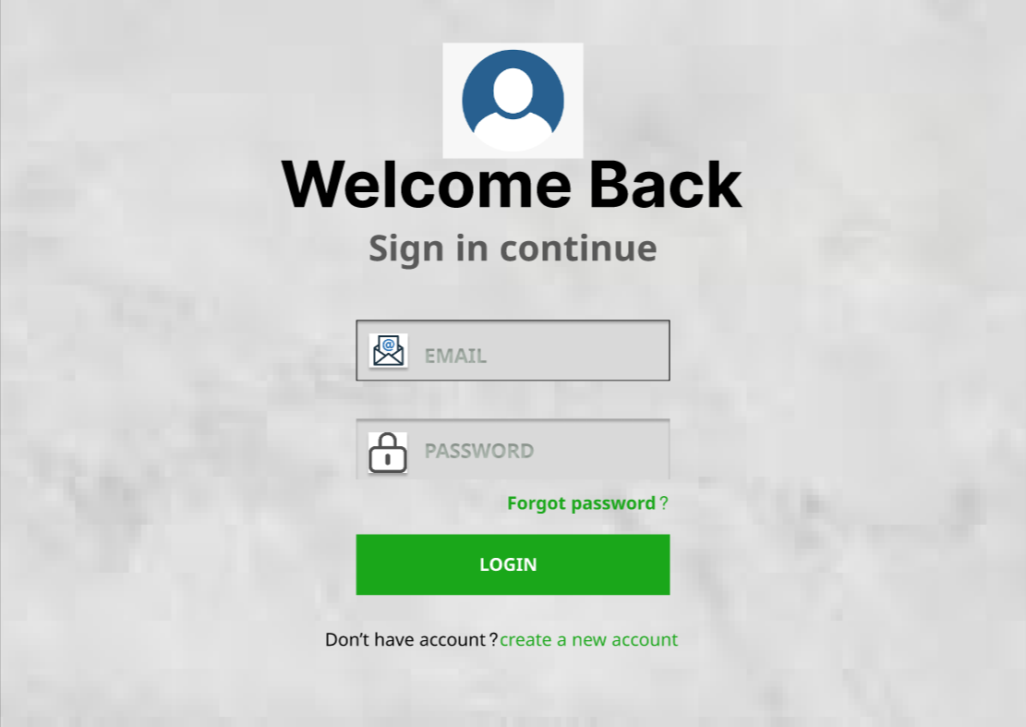
Login page :

Slide 4
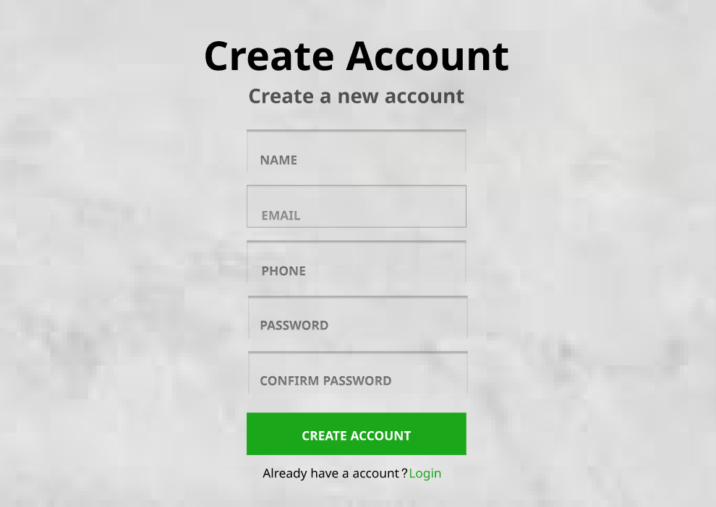
Sign up page :

Slide 5
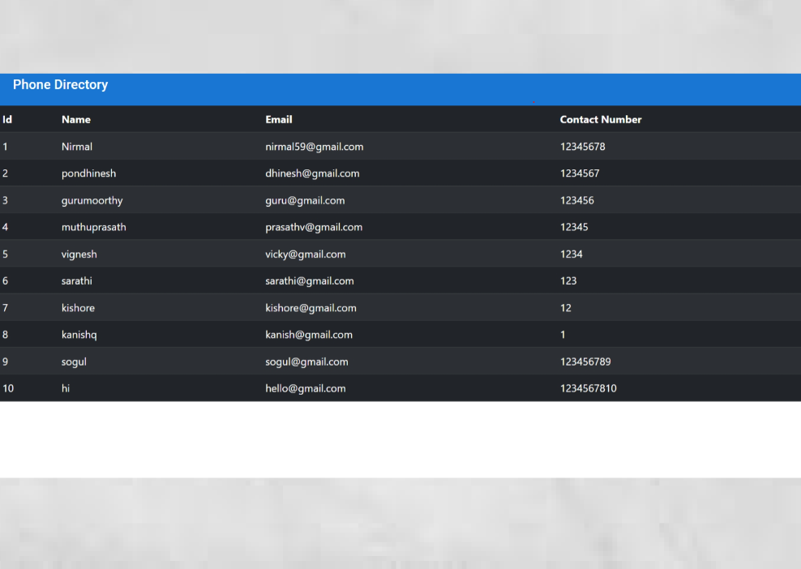
Phone directory page :

Slide 6
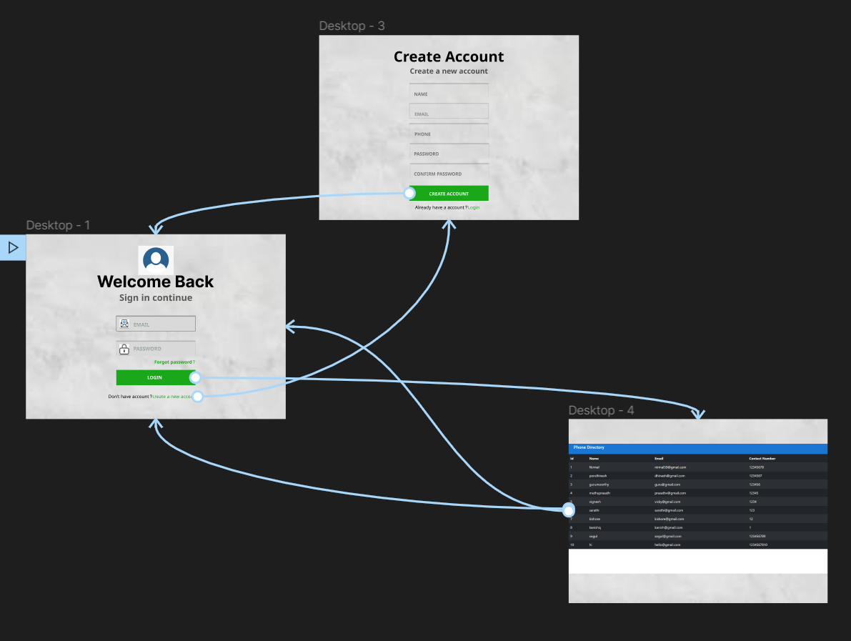
Flow path of the prototype :

Slide 7
figma Link :
https://www.figma.com/proto/no8G02yjURh9kTVqhsTWl3/Untitled?node-id=89%3A2&scaling=scale-down&page-id=0%3A1&starting-point-node-id=1%3A2

Slide 8
Thankyou

